Slide 1
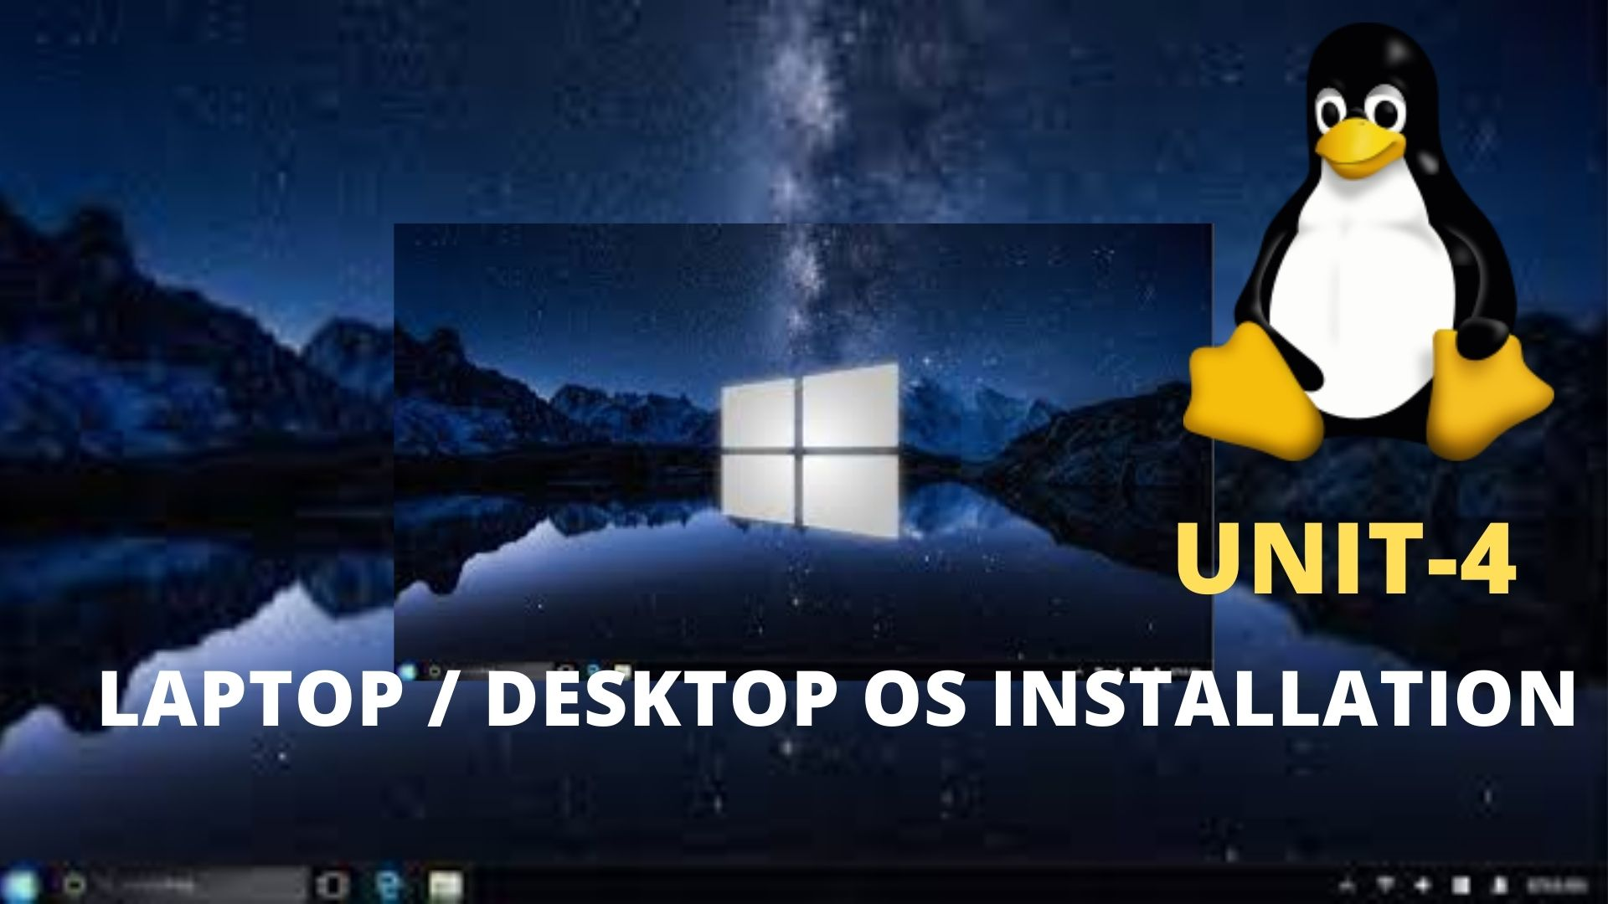
Computer Workshop
Unit-4
Laptop / Desktop OS Installation

Slide 2
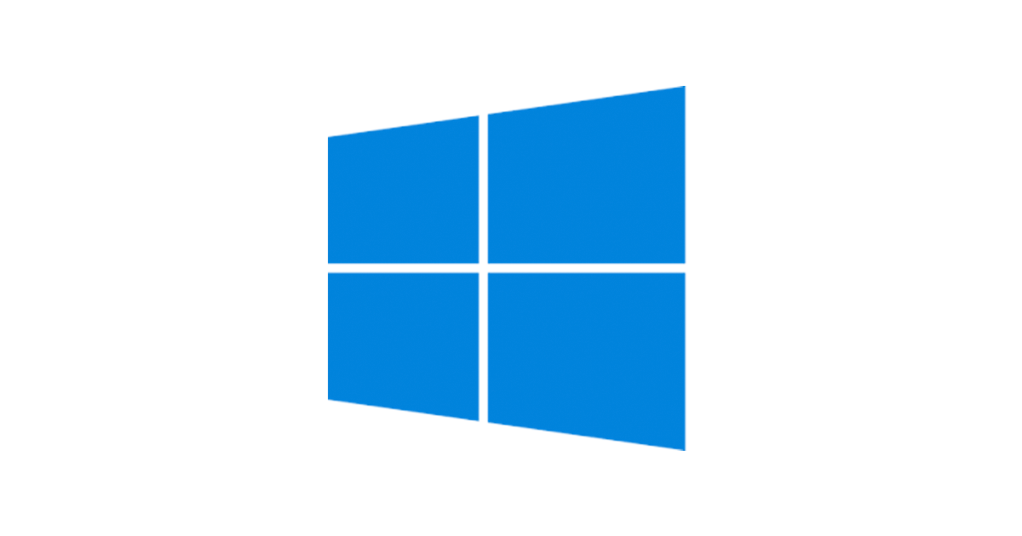

Objectives
To be able to install OS(Linux and windows) in Desktop/Laptop
Computer Workshop||Unit-4

Slide 3
Introduction to OS
An operating system (OS) is the system software that manages computer hardware, software resources and provides common services for computer program.
An operating system is a program that acts as an interface between the user and the computer hardware and controls the execution of all kinds of programs.
Computer Workshop||Unit-4

Slide 4
Some functions of OS
Memory Management: Keeps tracks of primary memory, i.e., what part of it are in use by whom, what part are not in use. In multiprogramming, the OS decides which process will get memory when and how much.
Processor Management: the OS decides which process gets the processor when and for how much time. This function is called process scheduling.
Device Management: manages device communication via their respective drivers.
File Management: Keeps track of information, location, uses, status etc.
Network Management: manages and administer a computer network.
Security: it prevents unauthorized access to programs and data.
Control over system performance: Recording delays between request for a service and response from the system.
Computer Workshop||Unit-4

Slide 5
Some functions of OS
Job accounting: Keeping track of time and resources used by various jobs and users.
Error detecting aids: Production of dumps, traces, error messages, and other debugging and error detecting aids.
Coordination between other software and users: Coordination and assignment of compilers, interpreters, assemblers and other software to the various users of the computer systems.
Computer Workshop||Unit-4

Slide 6
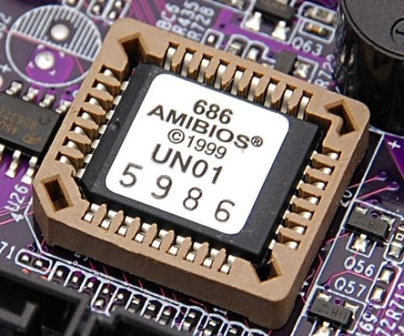
What is BIOS?
Just as animals rely on instincts to survive in the real world before they can learn from their experiences, a computer has a built-in program that tells it what to do before you load any software. This program is called the Basic Input/Output System because it tells the computer’s microprocessor how to get input from the outside world and send output there.
The BIOS defines how a computer acts and behaves before you load software. In modern computers, the BIOS has several additional functions, all essential to making the computers get started and work.
Computer Workshop||Unit-4

Slide 7
What is BIOS?
The BIOS is a boot firmware, designed to be the first code run by the PC when powered on.
The initial function of the BIOS is to identify ,test, and initialize the system devices such as the video display card, hard disk, floppy disk and other hardware.
The BIOS sets the machine hardware into a known state, so that software stored on the compatible media can be loaded, executed and given control to the PC.
Computer Workshop||Unit-4

Slide 8
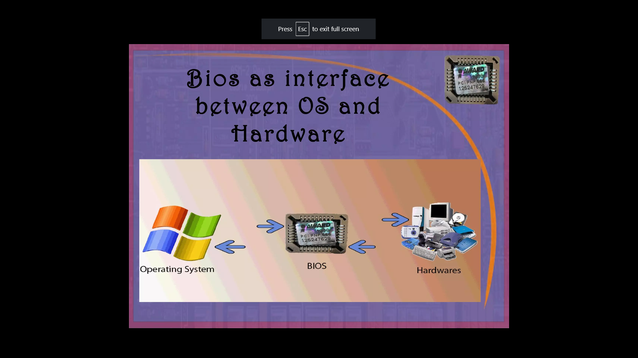
BIOS
BIOS acts as an interface between OS and hardware
Computer Workshop||Unit-4

Slide 9
Functions of BIOS
POST(Power On Self Test):One of the main functions of the BIOS is to give instructions for the Power On Self Test. The POST tests your computer’s processors, memory, chipset video adapter, disk controllers, disk drives , keyboard, and other crucial components.
Setup: The system configuration and setup program is usually a menu-driven program activated by pressing a special key during the POST, and it enables you to configure the motherboard and chipset settings along with the date and time, passwords, disk drives, and other basic system settings. You also can control the power-management settings and boot-drive sequence from the BIOS Setup, and on some systems, you can also configure CPU timing and clock-multiplier settings.
Computer Workshop||Unit-4

Slide 10
Functions of BIOS
Bootstrap loader: The program that lives within your computer’s EPROM or ROM, the bootstrap loader is tasked with reading your PC’s hard drive boot sector to move along the complete operating system load. When you restart your PC, the bootstrap loader activates the POST, then loads Windows 10 into memory. Newer PCs have replaced the bootstrap loader with an EFI, or Extensible Firmware Interface.
Computer Workshop||Unit-4

Slide 11
Typical BIOS setup menu
Main
Advanced
Security
Power
Boot
Exit
Computer Workshop||Unit-4

Slide 12
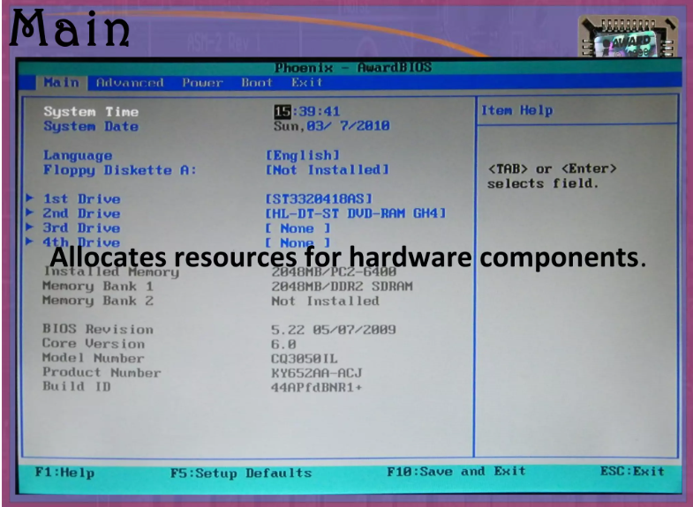
Typical BIOS setup menu
Computer Workshop||Unit-4

Slide 13
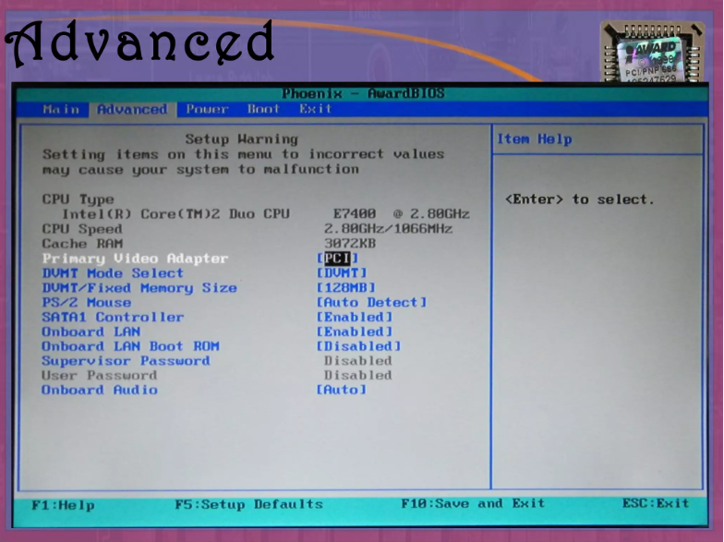
Typical BIOS setup menu
Computer Workshop||Unit-4

Slide 14
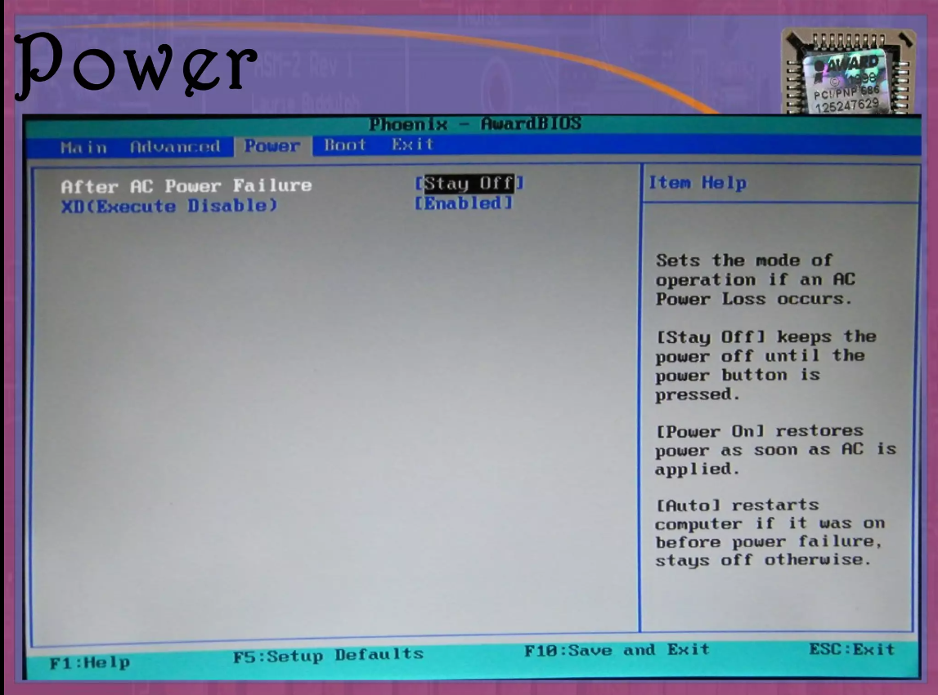
Typical BIOS setup menu
Computer Workshop||Unit-4

Slide 15
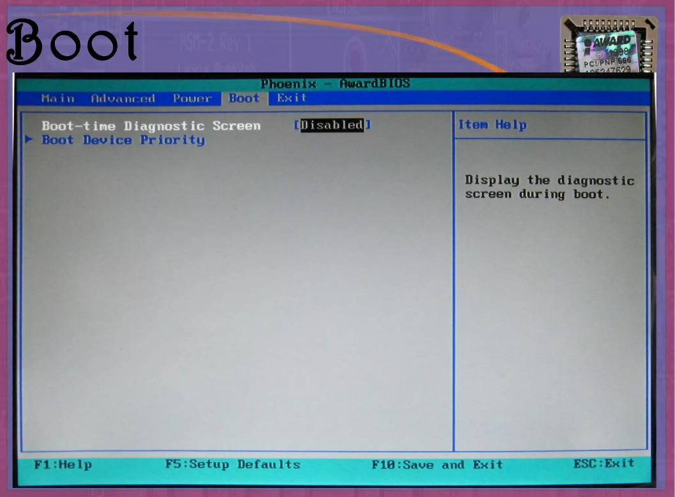
Typical BIOS setup menu
Computer Workshop||Unit-4

Slide 16
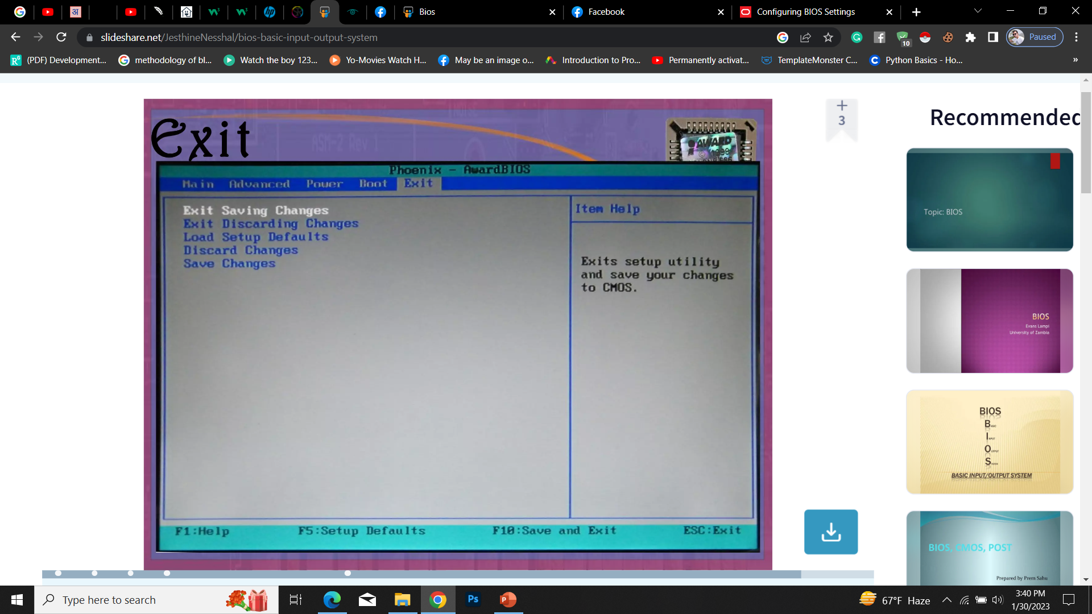
Typical BIOS setup menu
Computer Workshop||Unit-4

Slide 17
Firmware
Firmware is a programming that is written in to a hardware device’s non- volatile memory(ROM), where the content is saved when a hardware device is turned off or loses its external power source.
It is used to run the user programs on the device and can be thought of as the software that enables hardware to run.
Computer Workshop||Unit-4

Slide 18
Types of Firmware
There are different types of technology –specific firmware but all firmware can generally be sorted into 3 categories based on the level of hardware integration
Low level firmware: Low level firmware is considered an intrinsic part of a device’s hardware. It is often stored on non-volatile read only chips like ROM and therefore cannot be rewritten or updated. Devices containing low level firmware have one time programmable memory.
High level firmware: It allow updates and is generally more complex than low-level firmware. In computer, high level firmware resides on flash memory chips.
Subsystem firmware: It often comes as part of an embedded system. It is comparable to high level firmware that it can be updated and is more complex than low level firmware .
Computer Workshop||Unit-4

Slide 19
Applications of Firmware
Personal computer: The firmware of a personal computer -- either BIOS or unified extensible firmware interface -- comes embedded on a small memory chip on the computer's motherboard. A computer's peripherals, such as graphics and video cards, also contain firmware.
Storage devices: USB drives, hard drives and other portable storage devices contain basic firmware that enable them to function with a computer.
Mobile devices: Mobile phones, tablets, laptops and other mobile devices all contain firmware that let the hardware work with various software.
Home appliances: Dishwashers and washing machines are among the appliances that contain firmware. The firmware helps the machine communicate with the computer used to configure the machine's settings and control its operation.
Smart cards: Smart cards have instructions embedded in a chip that provides the card's basic functionality, as well as authentication and encryption.
Computer Workshop||Unit-4

Slide 20
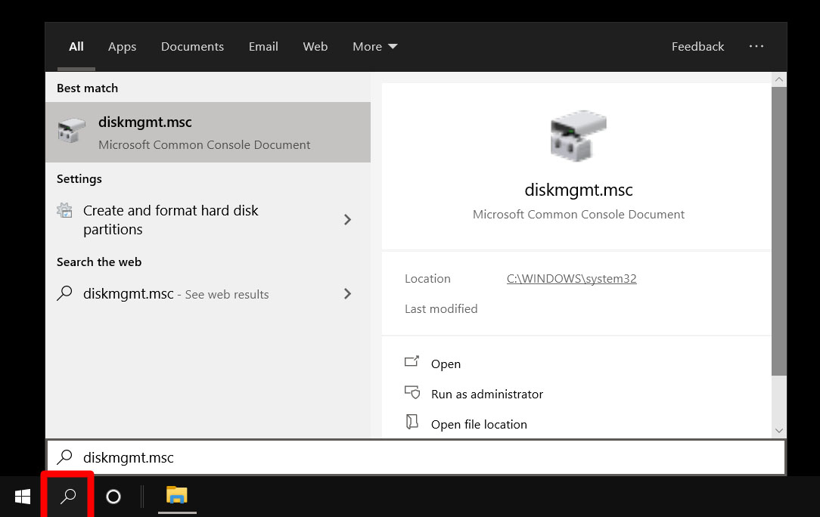
How to partition Hard disc in window 10
Open the Windows Search Bar. This is the magnifying glass-shaped icon in the bottom-left corner of your screen.
Then type “DISKMGMT.MSC” in the search bar and hit enter.
Computer Workshop||Unit-4

Slide 21
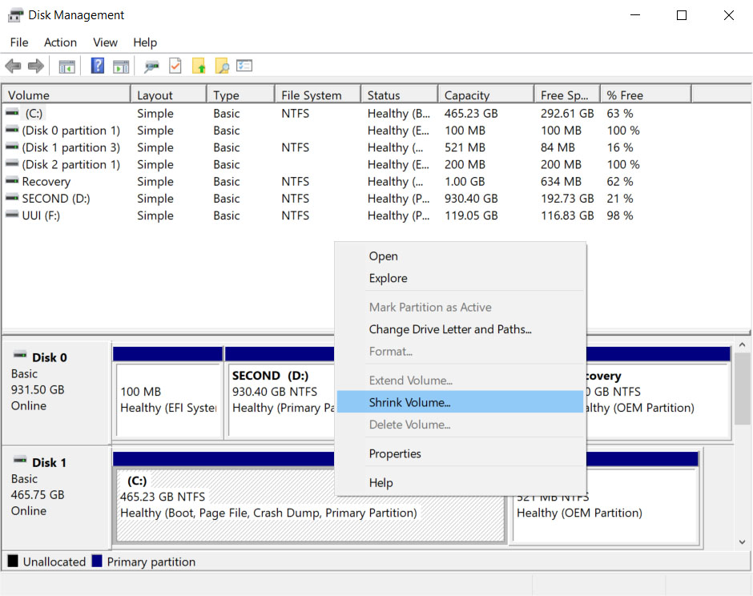
How to partition Hard disc in window 10
3. Right-click on your main hard drive and select Shrink Volume. If you have more than one drive, make sure to choose the one that says Primary Partition. This will usually be labeled as the C: drive.
Computer Workshop||Unit-4

Slide 22
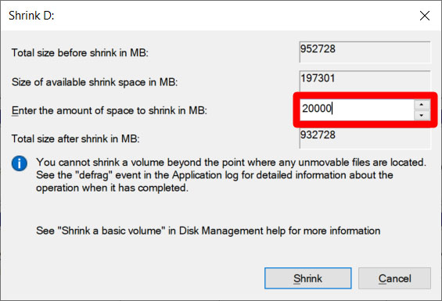
How to partition Hard disc in window 10
4. Then choose how much you want to shrink your drive. It is recommended that you set aside at least 20GB (20,000MB) for Linux.
5. Finally, click Shrink.
Computer Workshop||Unit-4

Slide 23
How to make Linux Bootable USB
Download a Linux distro in ISO format. An ISO file is a disk image. Some of the top options are Ubuntu, Mint, or Fedora. They are free to download from each distribution’s main website.
Insert the USB drive into your computer. You might be asked to format your drive. This will erase all the data stored on your drive, so make sure to back up your files before you begin.
Download Rufus.
Open Rufus and select your USB drive from the Device list. If you don’t know which drive to use, eject all other drives until you only have one to choose from.
Computer Workshop||Unit-4

Slide 24
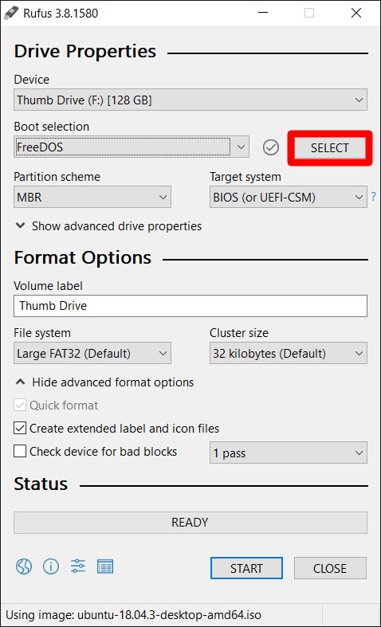
How to make Linux Bootable USB
Under Boot Selection, click the Select button and choose the ISO file you downloaded earlier. Don’t change the other default settings.
Computer Workshop||Unit-4

Slide 25
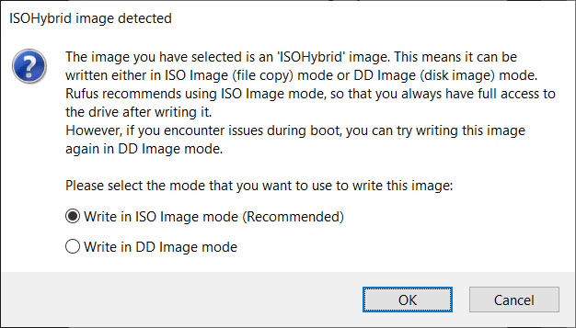
How to make Linux Bootable USB
Finally, click Start. If you get a pop-up message asking you to select a mode that you want to use to write the image, choose ISO.
Then wait for Rufus to mount your ISO file onto your drive. This might take some time, so be patient if the progress bar gets stuck.
Computer Workshop||Unit-4

Slide 26
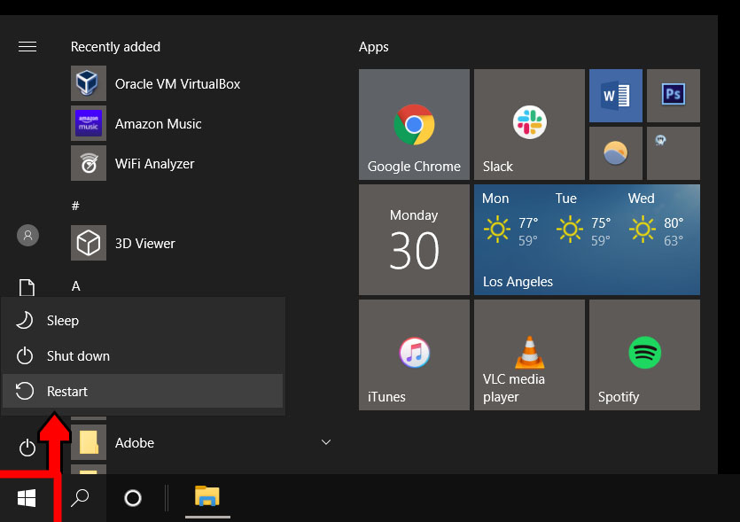
How to install Linux from USB
Insert a bootable Linux USB drive.
Click the start menu. This is the button in the lower-left corner of your screen that looks like the Windows logo.
Then hold down the SHIFT key while clicking Restart.
This will take you into the Windows Recovery Environment.
Then select Use a Device.
Computer Workshop||Unit-4

Slide 27
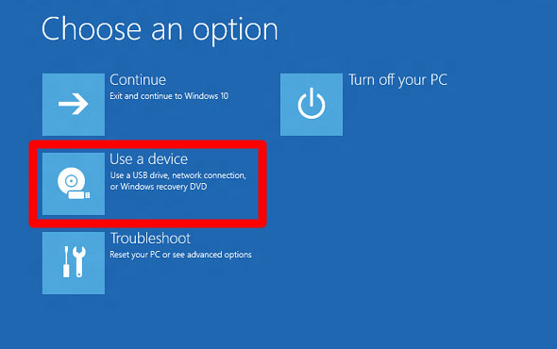
How to install Linux from USB
Computer Workshop||Unit-4

Slide 28
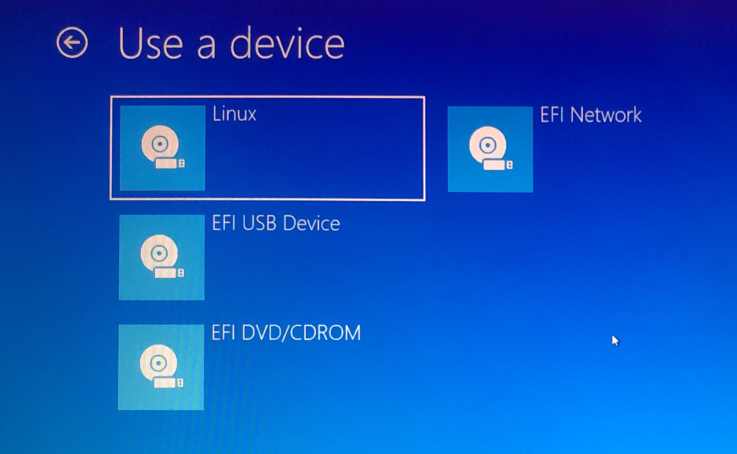
How to install Linux from USB
Find your device in the list. If you don’t see your drive, choose EFI USB Device, then pick your drive from the next screen.
Your computer will now boot Linux. If your computer reboots Windows, there was either an issue with your drive, or you might have to change settings in your BIOS.
Warning: Changing BIOS settings can damage your computer if you don’t know what you’re doing.
Computer Workshop||Unit-4

Slide 29
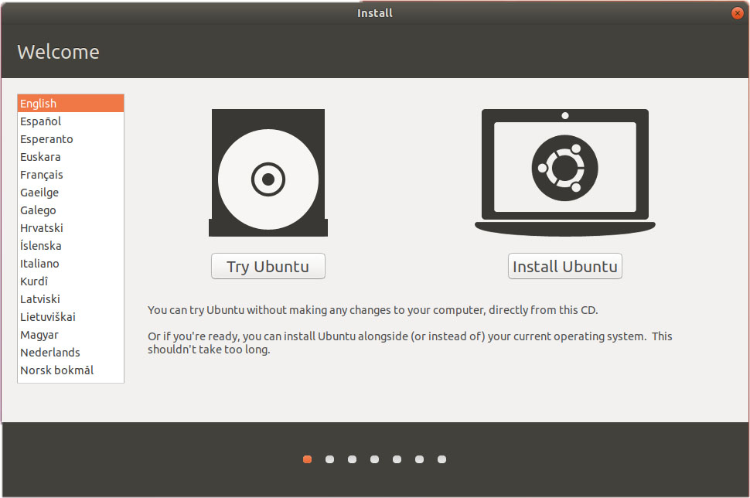
How to install Linux from USB
Select Install Linux. Some distros also let you try out the OS before installing it here.
Computer Workshop||Unit-4

Slide 30
How to install Linux from USB
Go through the installation process. This will differ depending on which distro you are trying to install. These details might include your WiFi network, language, time zone, keyboard layout, etc. You might also be required to create an account with a username and password. Make sure to write down any details, as you will likely need them in the future.
Most distros will allow you to partition your drive or erase it and do a clean install during the installation.
Computer Workshop||Unit-4

Slide 31
How to install Linux from USB
Select Install Linux. Some distros also let you try out the OS before installing it here.
Computer Workshop||Unit-4

